Slide 1
Unit test
Level Of Testing / Test Objectives / Unit test & TDD

Slide 2
Topic
Level Of Testing
Test Objectives
Unit Test
TDD (Test Driven Development)
Example
Assignment

Slide 3
Level Of Testing
Unit test(white box & black box testing technique)
Integration Test (For small size)

Slide 4
Level Of Testing
System Test
Functional
Non-Functional Test
Performance Test
Load Test
Stress Test
Security Test
Reliability / Availability Test
Disaster & Recovery Test (data backup & data recovery Test)
Horizontal Scalable

Slide 5
Level Of Testing
System Integration Test (SIT – For large size)
End to End Test (E2E)
Regression Test
User Acceptance Test (UAT)
Alpha (in-house test)
Beta

Slide 6
Level Of Testing
Level | Summary
Unit Testing | A level of the software testing process where individual units of a software are tested. The purpose is to validate that each unit of the software performs as designed.
Integration Testing | A level of the software testing process where individual units are combined and tested as a group. The purpose of this level of testing is to expose faults in the interaction between integrated units.
System Testing | A level of the software testing process where a complete, integrated system is tested. The purpose of this test is to evaluate the system’s compliance with the specified requirements.
Acceptance Testing | A level of the software testing process where a system is tested for acceptability. The purpose of this test is to evaluate the system’s compliance with the business requirements and assess whether it is acceptable for delivery.

Slide 7
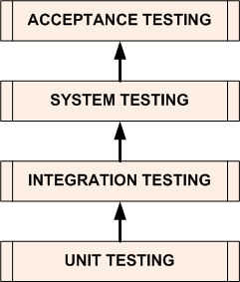
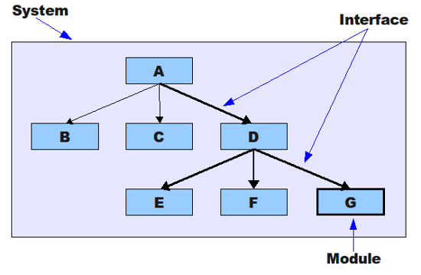
Level Of Testing

Slide 8
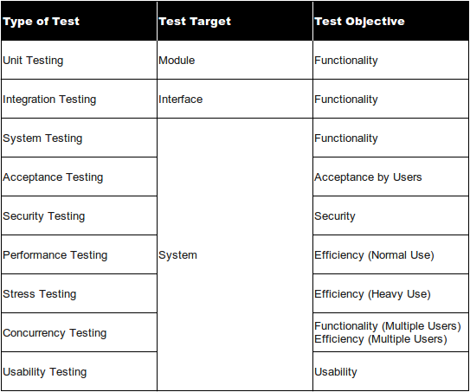
Test Objectives

Slide 9
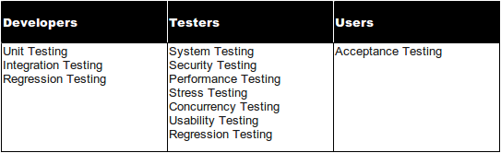
Who Tests

Slide 10
Unit Test
“ A unit test is a piece of a code (usually a method) that invokes another piece of code and checks the correctness of some assumptions afterward ”
From The Art Of Unit Testing

Slide 11
3A : Arrange, Act, Assert
Arrange: setup everything needed for the running the tested code. This includes any initialization of dependencies, mocks and data needed for the test to run.
Act: Invoke the code under test.
Assert: Specify the pass criteria for the test, which fails it if not met.

Slide 12
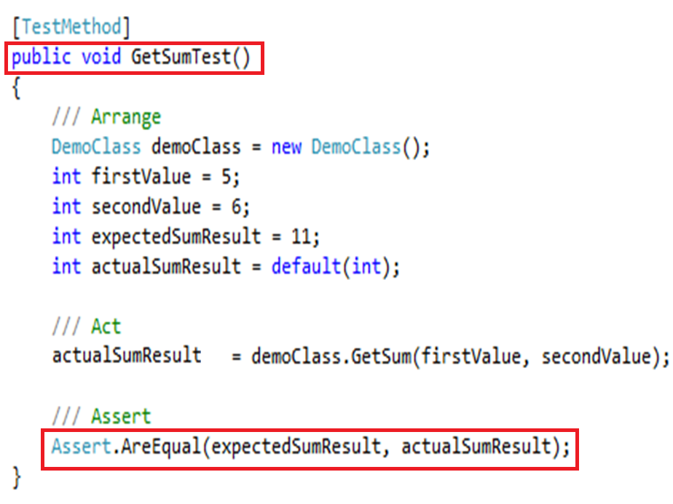
Example

Slide 13
TDD (Test Driven Development)
Test driven development (TDD) is an software development approach in which a test is written before writing the code. Once the new code passes the test, it is refactored to an acceptable standard.

Slide 14
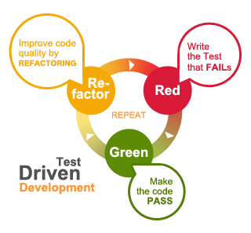
TDD (Test Driven Development)
The motto of test-driven development is
"Red, Green, Refactor.“
Red: Create a test and make it fail.
Green: Make the test pass by any means necessary.
Refactor: Change the code to remove duplication in your project and to improve the design while ensuring that all tests still pass.

Slide 15
Assignment
Create Unit test Project
Create class library project
Create class and implement code following file assignment
Write unit test for each methods coverage case
Create new branch name “unit-test”
Add folder “Unit test” and add all file (solution + unit test project + class library) in folder “Unit test” commit push to branch unit-test
Merge branch unit-test to master

